Slide 1
Fake News Detection
Under the Guidance of
Prof Dr P Venkata Subba Reddy sir
By
R Naveen Kumar (11406050)
V Lakshmi Poojitha(11406057)
R Irfan(11406065)

Slide 2
Contents
Abstract
Problem Definition
Existing System
Proposed System
System design
- Flow Chart
- Class Diagram
Hardware Requirements
Software Requirements
References

Slide 3
Abstract:
The extensive spread of fake news has the potential for extremely negative impacts on individuals and society.
Fake news is intentionally written to mislead readers to believe false information, which makes it difficult and nontrivial to detect based on news content
Fake news detection on social media has recently become an emerging research that is attracting tremendous attention.
We propose a system which uses big data analytics on fake news datasets to detect fake news

Slide 4
Problem Definition :
Social media for news consumption is a double-edged sword.
Easy access of information lead people to seek out and consume news from social media.
On the other hand, it enables the wide spread of fake news
fake news can break the authenticity balance of the news ecosystem.
To help mitigate the negative effects caused by fake news we need to develop methods that automatically detect fake news on social media.

Slide 5

Example:
Popular rumor in recent times, Rs 2000 note with Tracker chip

Slide 6
Existing System:
Most of the existing system analytics are based on words of the article.
Few of them are completely based on keyword matching.
Existing systems are using manual reporting techniques to block fake articles.

Slide 7
Proposed System:

Slide 8
Proposed System:
We propose a system which uses big data analytics and machine learning on fake news datasets to detect fake news.
We use fake news open data sets for analytics
Keyword matching using Map reducing techniques
When Features of an article are matched with fake news datasets ,then this article is analyzed and classified under fake category
Example:
By Using text-matching algorithms to link tweets
to verified rumors in twitter

Slide 9
Big data part
Using the available datasets we calculate the probability of each word that contribute to the fake news.
By using the big data analytics we update the score of each word we come across while analyzing
We update the score by adding the probability function value.
A simple probability function is as follows:
Count=number of occurrences of the word in the fake news
Total=Total number of occurrences of the word in the dataset.
P(word)=Count/Total.

Slide 10
The machine learning part
The probabilities in the first part are inputs this model as one of the features in the feature vector.
First, using our training dataset we build a model We can access this model using p(x)
  This asks, "What is the probability that example x is normal"
Having built a model if p(x_{test}) < ε --> flag this as an anomaly
if p(x_{test}) >= ε --> this is OK
ε is some threshold probability value which we define, depending on how sure we need/want to be.

Slide 11
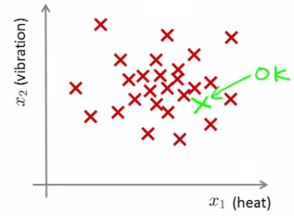
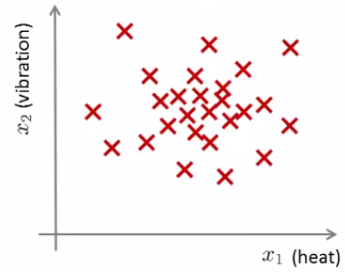
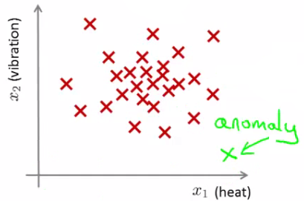
For example:
X2(reviews)
X2(reviews)
X1(score)
X1(score)
X2(reviews)
X1(score)

Slide 12
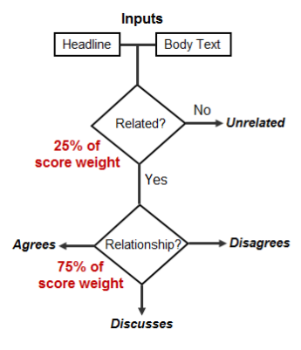
Flow Chart :

Slide 13
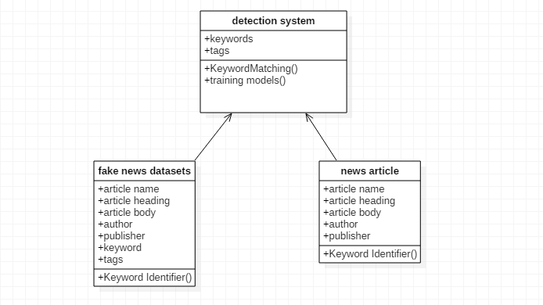
Class Diagram

Slide 14
Web page with Fake news
Real (Fake) News Article
Article Body
Alert ! This is fake news.

Slide 15
Hardware Requirements
Intel core i3 processor/higher end 64 bit processor
8 GB or More RAM
10 GB of hard disk space
Cloudera, Hortonworks
Cloud infrastructure as per requirements

Slide 16
Software Requirements
Hadoop Stack
Linux Operating System
JDK 1.6 or higher

Slide 17
Conclusion
Fake news affecting society and our individual’s perception.
Our proposed system could eradicate the fake news problem to the maximum extent, with the big data and analytics.
This will not only improve our understanding of the world.
Also minimise the polarisation in society

Slide 18
References:
Sadia Afroz, Michael Brennan, and Rachel Greenstadt Detecting hoaxes, frauds, and deception in writing style online. In ISSP'12.
Jonas Nygaard Blom and Kenneth Reinecke Hansen. Click bait: Forward-reference as lure in online news headlines. Journal of Pragmatics, 76:87{100, 2015.
Research.facebook.com

Slide 19
Thank you

